Slide 1




2022 Safe Roads Competition
Group members:
Hui Ling Hip
Shuo Chen
Tu Nguyen
Yixuan Chen
Yuko Kurokawa

Slide 2
01. Introduction
AGENDA
02. Data Exploration
03. Factors Analysis
04. Location Analysis
05. Recommendations

Slide 3
INTRODUCTION
Dataset
KSI – Killed or Severely Injured
Hazardous Driving Area Dataset
Data Preparation
Research Questions:
Which are the most accident / hazardous-prone locations?
Which factors are most important to focus on?
Are there sensitive areas that are particularly risky with respect to more serious accidents?
Data Manipulation
Data Exploration
Factors Analysis
Environmental & Behavioural Descriptive Analysis
Location Analysis
Sensitive Locations / Areas
Findings
Recommendations

Slide 4
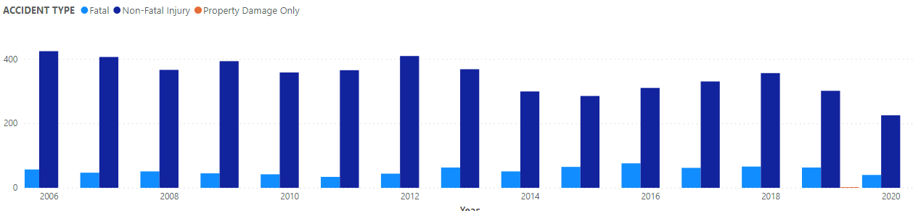
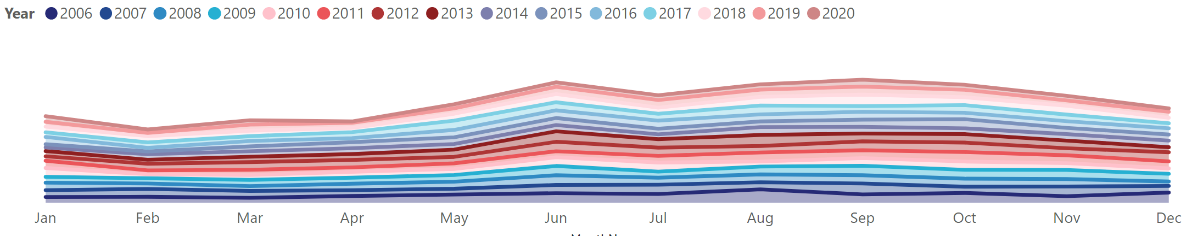
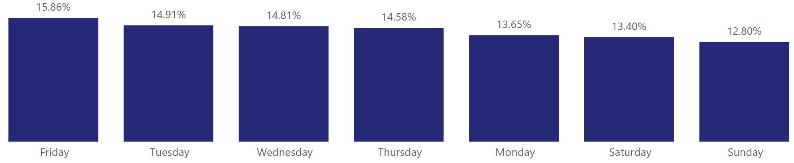
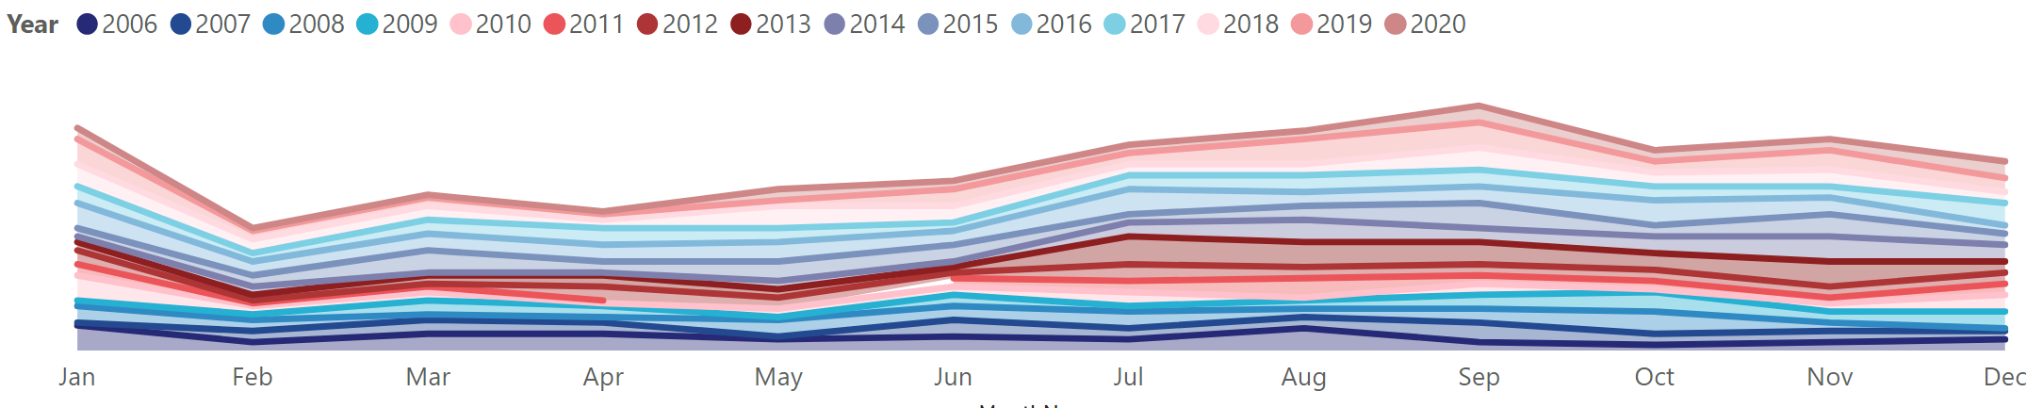
DATA EXPLORATION
within a year, June, August, September, and October are higher than the others.
The overall number of KSI incidents fluctuates every year until both fatal and non-fatal cases have reduced in recent years.
Fatal accidents
January and September have much higher frequency of fatal accidents than others.
Friday has a higher of total accidents within a week.

Slide 5
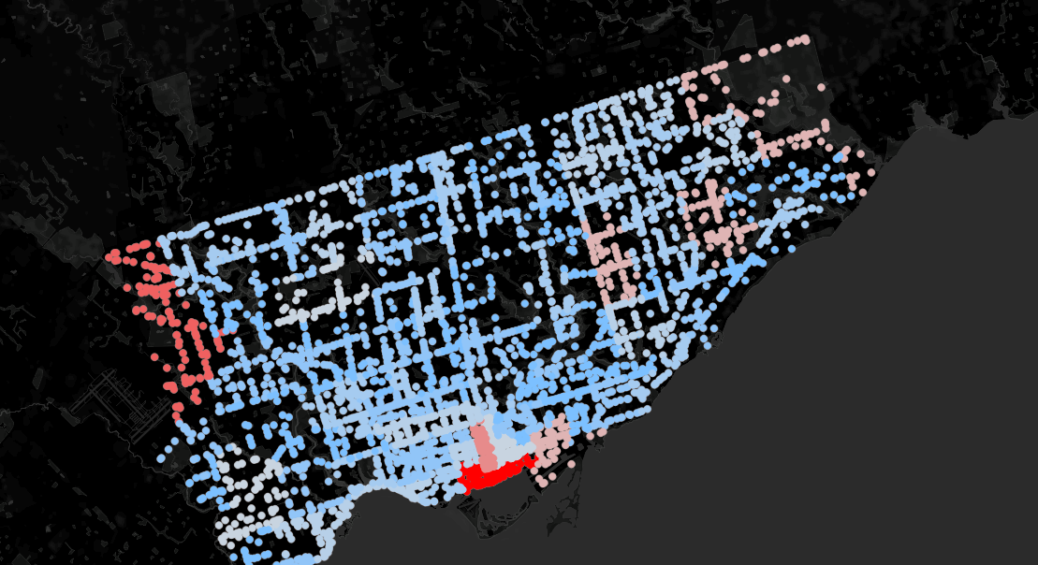
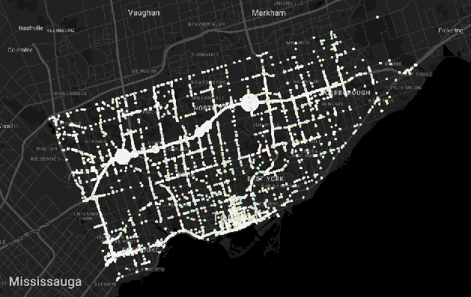
DATA EXPLORATION
Based on KSI dataset:
Toronto and East York districts have the most accidents - 35%
Waterfront Communities has the highest number of accidents - 3.7%
West Humber-Clairville - 2.9%
Bay Street Corridor - 2.4%
Based on Hazardous Driving Area dataset:
43.766, -79.363
43.713, -79.538
43.737, -79.432
Common features:
401 freeway
Ramp

Slide 6
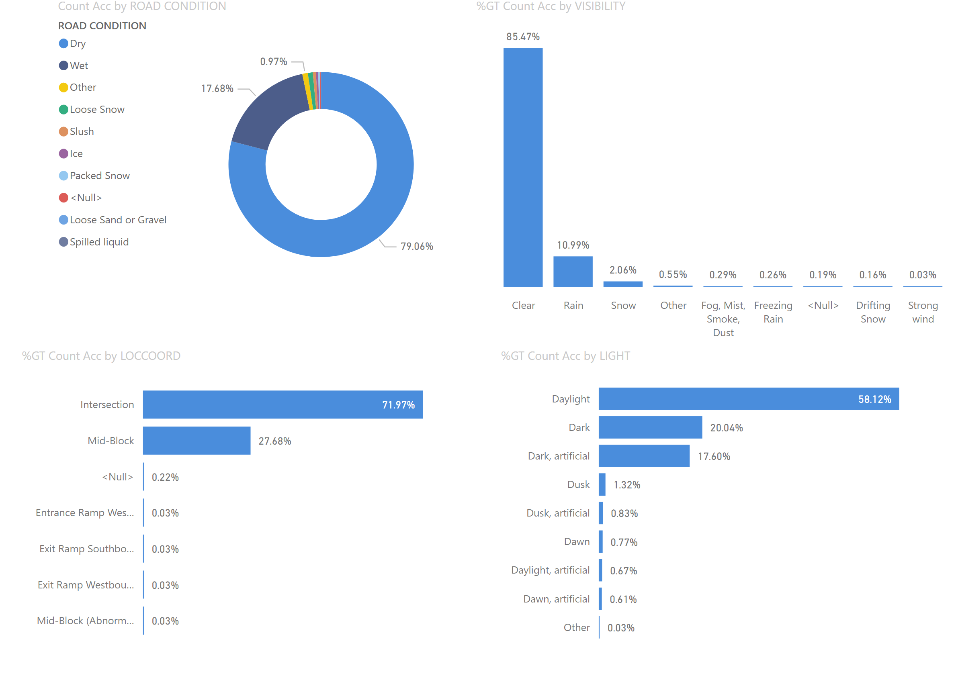
DATA EXPLORATION
Daylight – 58%
Intersection – 72%
Clear Visibility – 85%
Dry Road Condition – 79%

Slide 7
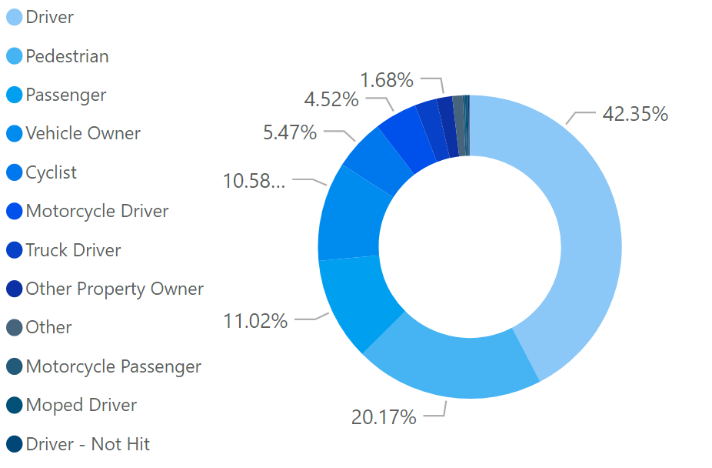
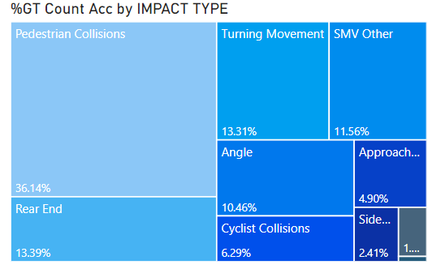
DATA EXPLORATION
Impact type – 36% is pedestrian collision
Involvement type - 20% is pedestrian

Slide 8
FACTORS ANALYSIS
 | Features | Conditions
1 | Road Condition | Packed Snow
2 | Visibility | Other (except Clear, Drifting Snow, Fog|Mist|Smoke|Dust, Freezing Rain, Rain, Snow, Strong Wind)
3 | Road Condition | Other (except Dry, Ice, Loose Sand and Gravel, Loose Snow, Packed Snow, Slush, Spilled Liquid, Wet)
3 most important environmental features among Visibility, Light and Road Condition

Slide 9
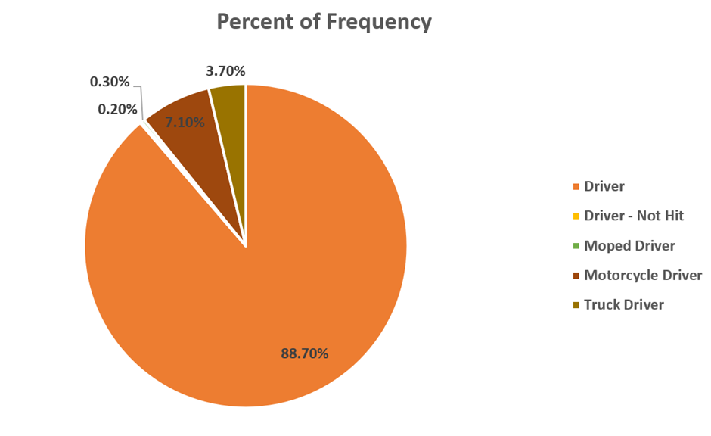
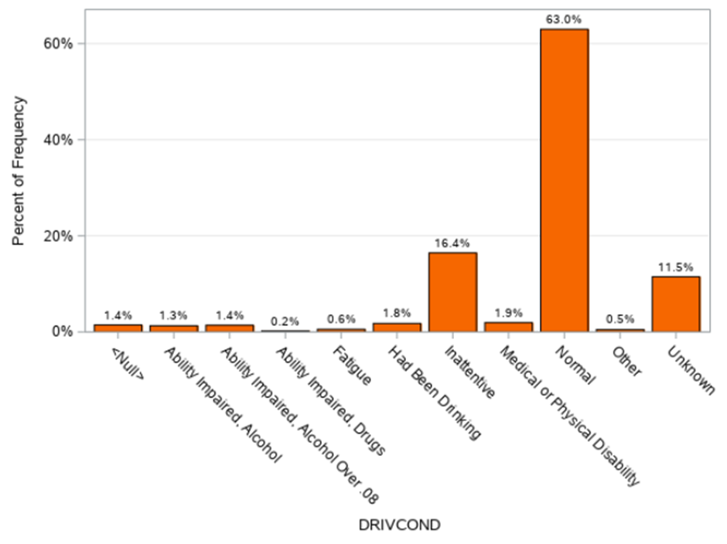
FACTORS ANALYSIS
Inattentive condition takes the highest proportion among adverse driving conditions.

Slide 10
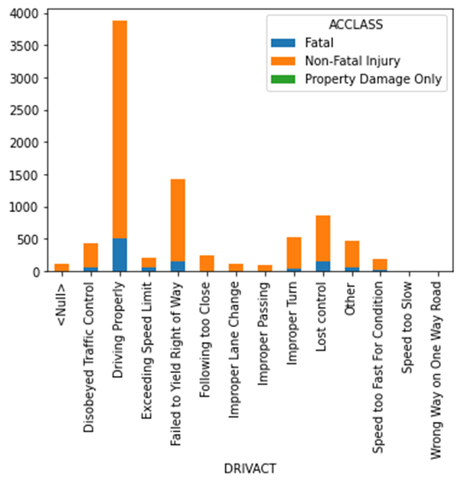
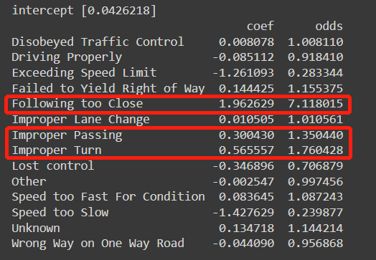
FACTORS ANALYSIS
More likely to result in fatal accidents:
Following too Close
Improper Turn
Improper Passing
Most frequent driving misconduct: Failed to Yield Right of Way

Slide 11
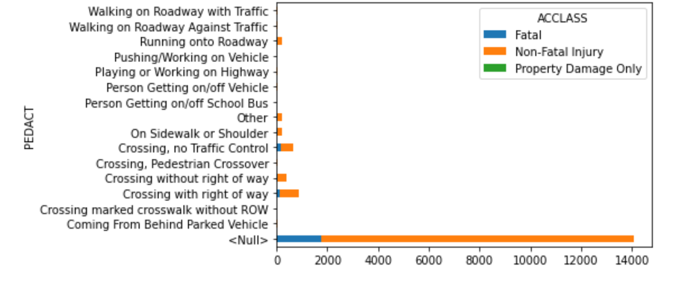
BEHAVIORAL FACTOR ANALYSIS
1 | Pedestrian hit at mid-block
2 | Pedestrian hit at parking lot
2 types of pedestrian crash
Most of the non-fatal injury accidents occur due to failure of crossing with right of way

Slide 12
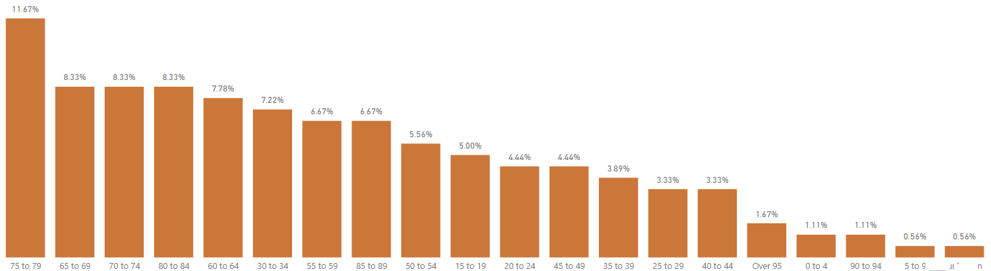
BEHAVIORAL FACTOR ANALYSIS
Fatal accidents happened when pedestrian hit at mid-block

Slide 13
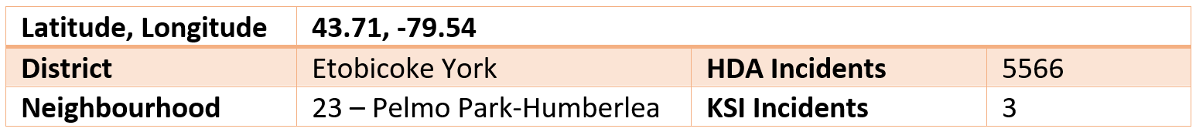
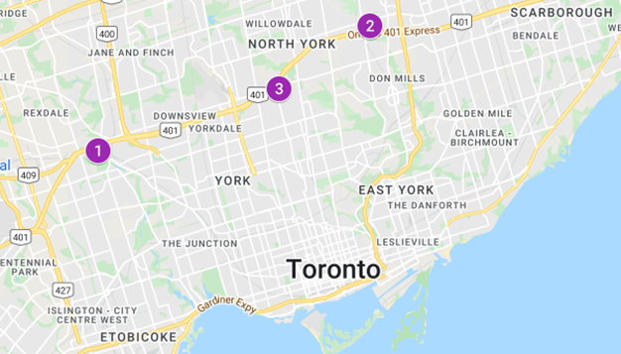
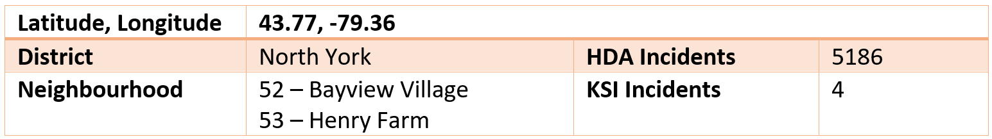
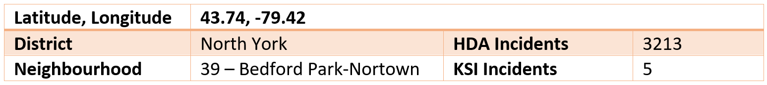
LOCATION ANALYSIS
KSI + HDA Datasets
Top 3 locations with the highest number of harsh braking incidents and accident-level events.
Location 1
Location 2
Location 3

Slide 14
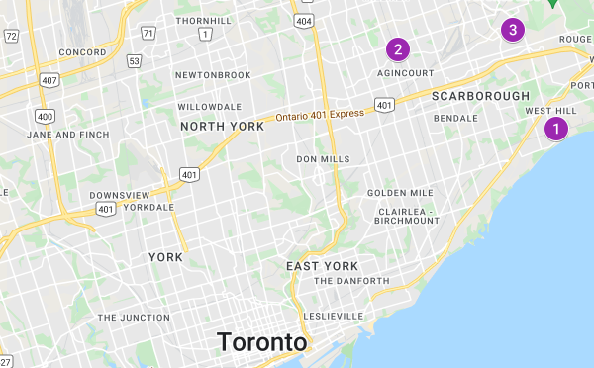
LOCATION ANALYSIS
KSI + HDA Datasets
Top 3 locations with the highest average severity score (harsh braking incidents + accident-level events + traffic flow).

Slide 15
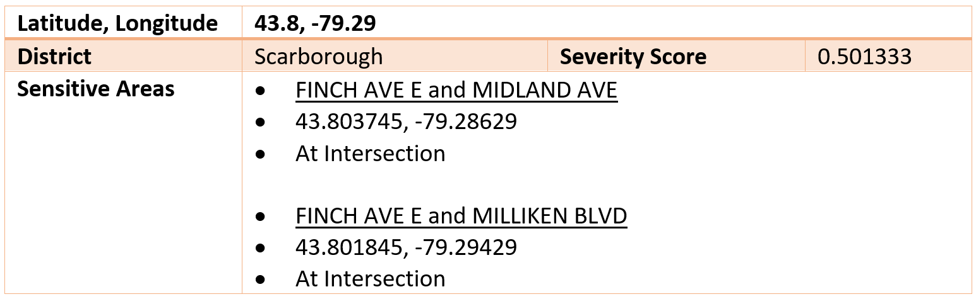
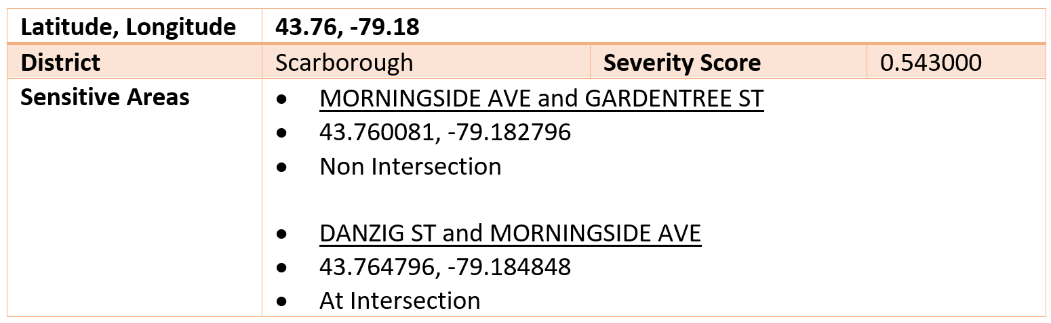
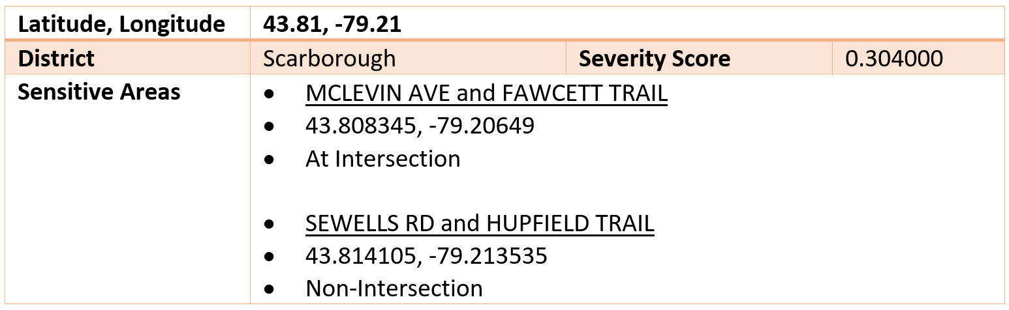
LOCATION ANALYSIS
Area 2
Sensitive areas (in close proximity to school, church, community centre, park, etc.) that are particularly risky with respect to more serious accidents.
Area 1
Area 3

Slide 16
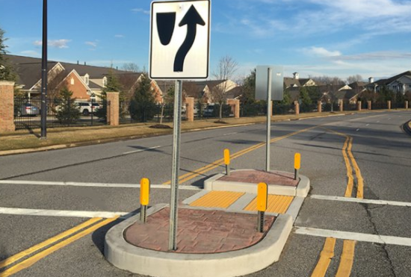

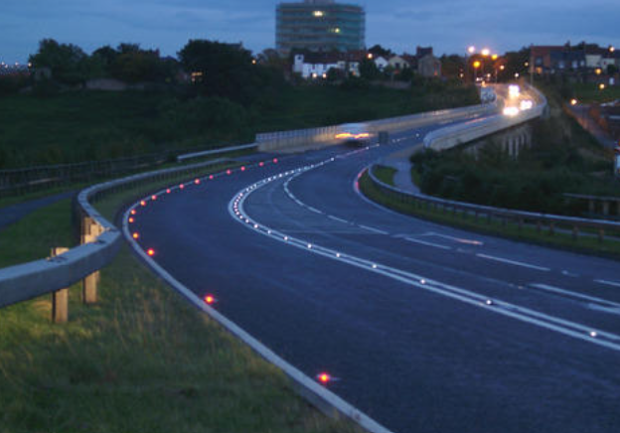
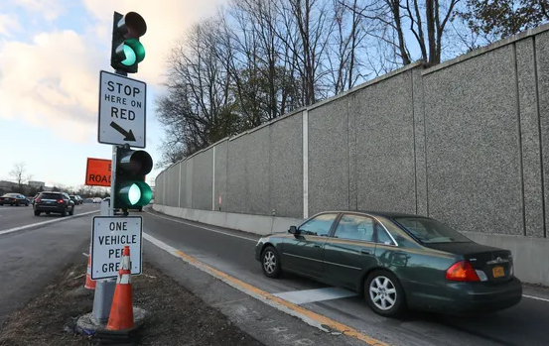
RECOMMENDATIONS
Road Safety Campaign
Increase public awareness on traffic laws and regulations, safe driving practices, and other road safety related issues.
Pedestrian Refuge Islands
Increase pedestrian refuge islands at the areas with higher population of seniors or other slow moving pedestrians to help them crossing the road safely in 2 phases.
Ramp Metering Systems
Regulates the flow of traffic entering freeways according to current traffic conditions to reduce the number of accidents.
ITS903 FREEWAY RAMP METERING. 2020-03-26, Ontario. http://www.mto.gov.on.ca/english/publications/pdfs/its903-freeway-ramp-metering.pdf
Road Studs
Lane marking and delineation to increase visibility of the drivers at night time and bad weather conditions.

Slide 17

Thank you

